Slide 1


MEAL PREP APPLICATION
OPTIMUS(GROUP 18)

Slide 2

TARGET AUDIENCE AND USAGE ENVIRONMENT
Users
Independent Cook: Working professionals, Students, middle-aged and elderly people
Passionate Cook: People willing to learn new recipes
Limited Knowledge Cook: People with limited knowledge about cooking
Environment
Users can use the app whenever they wish to, but they need internet connectivity to view the recipes

Slide 3
APPLICATION FEATURES
View different cuisines and most viewed recipes
User can search for a different recipes
Watch a recipe video
Share a recipe video
Add a recipe to your recipe list
Export ingredient list
Secured Log In/Sign up
Upload the recipe

Slide 4

USABILITY, SECURITY, ACCESSIBILITY
Usability
Business Model - Simple and user-friendly interface
Proper error messages and validations
Run time validations
Security
User Authentication
Accessibility
Text
Internet is required to access the application

Slide 5


BENEFITS OF APPLICATION
Users can find different recipes according to their taste.
Recipe information is available in both video and text formats
Shows all the ingredients required for the recipe
Displays all the nutritional information related to the recipe
User can also upload the recipe

Slide 6


AVAILABILITY AND COST
Application is available on Google Play Store
Free Model

Slide 7
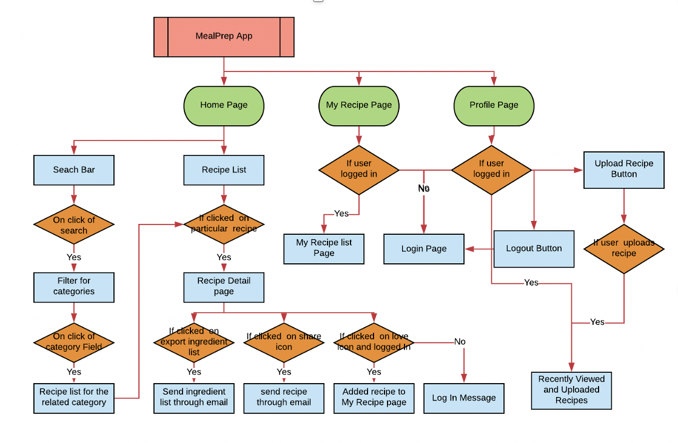
ARCHITECTURE

Slide 8
PROBLEMS ENCOUNTERED
GitHub Merge Issues
Faced issues while committing the code as there were merge conflicts in some on the files which needs to be resolved before committing the code .

Slide 9

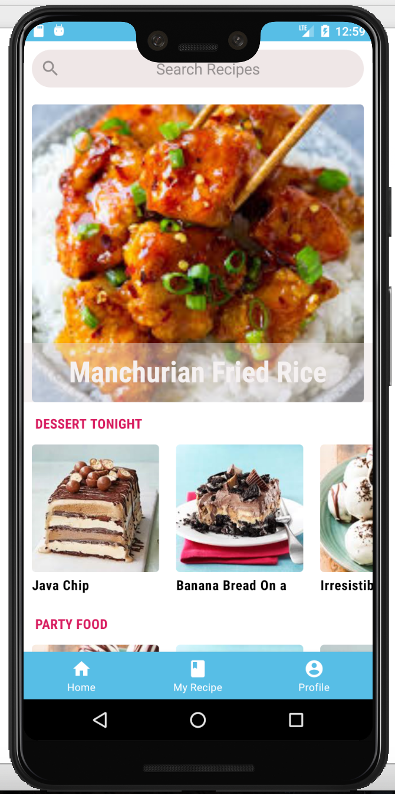
ACCOMPLISHMENTS
Minimum Functionality
Home Page

Slide 10
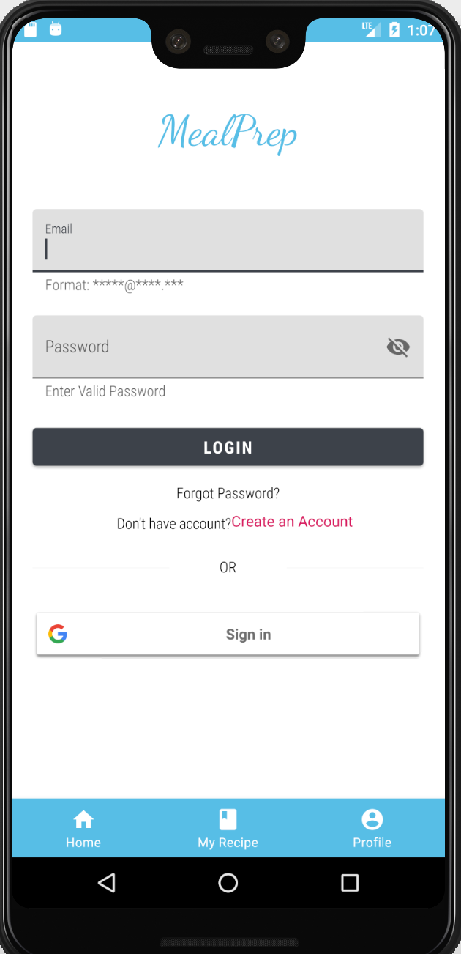
ACCOMPLISHMENTS
Minimum Functionality
Home Page
Login/Sign In

Slide 11
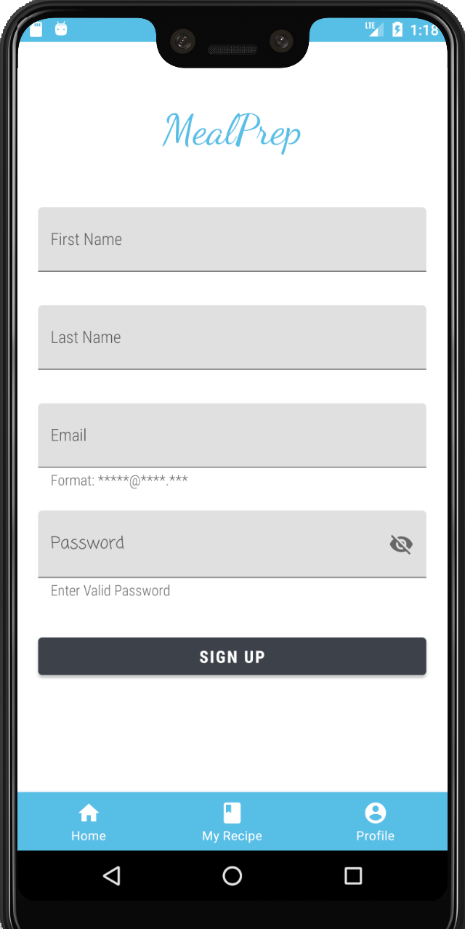
ACCOMPLISHMENTS
Minimum Functionality
Home Page
Login/Sign In
Sign Up

Slide 12
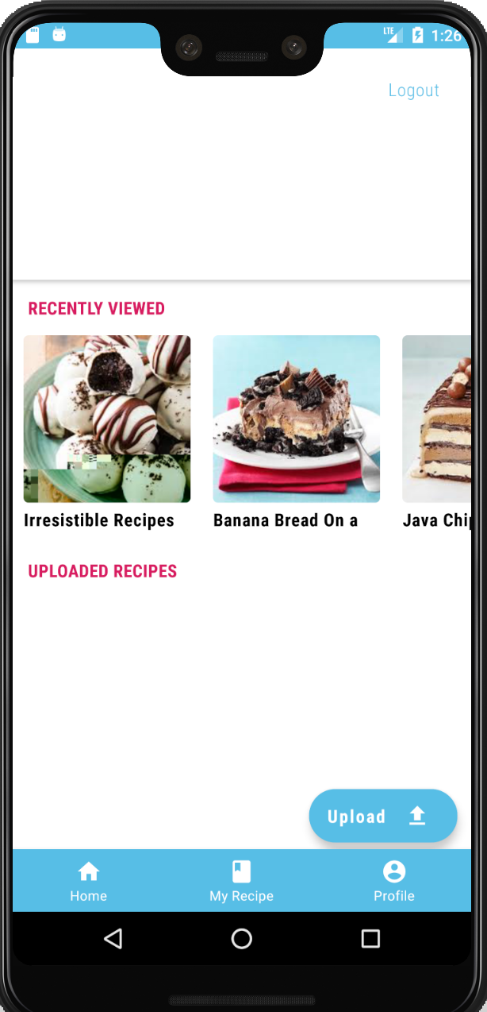
ACCOMPLISHMENTS
Minimum Functionality
Home Page
Login/Sign In
Sign Up
Profile Page

Slide 13
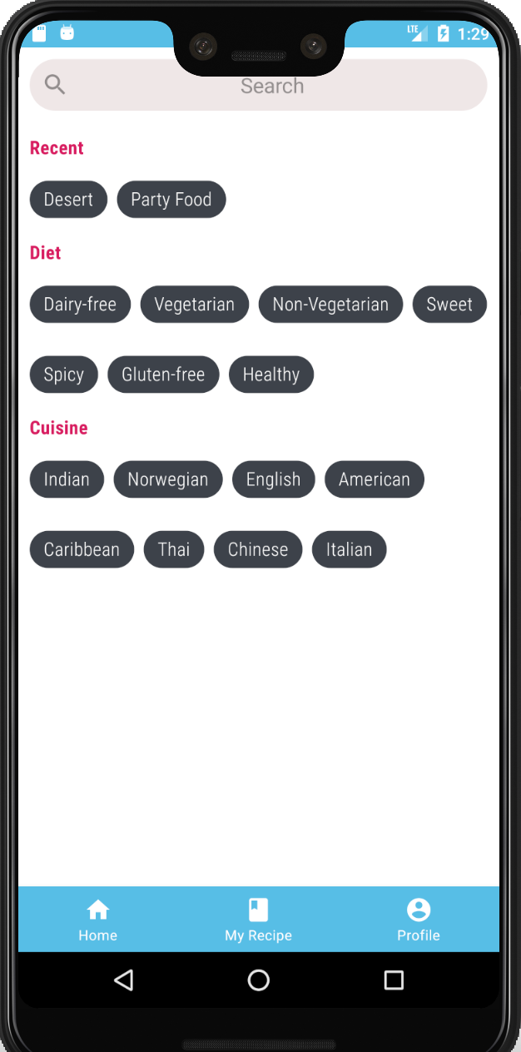
ACCOMPLISHMENTS
Minimum Functionality
Home Page
Login/Sign In
Sign Up
Profile Page
Search Recipe

Slide 14
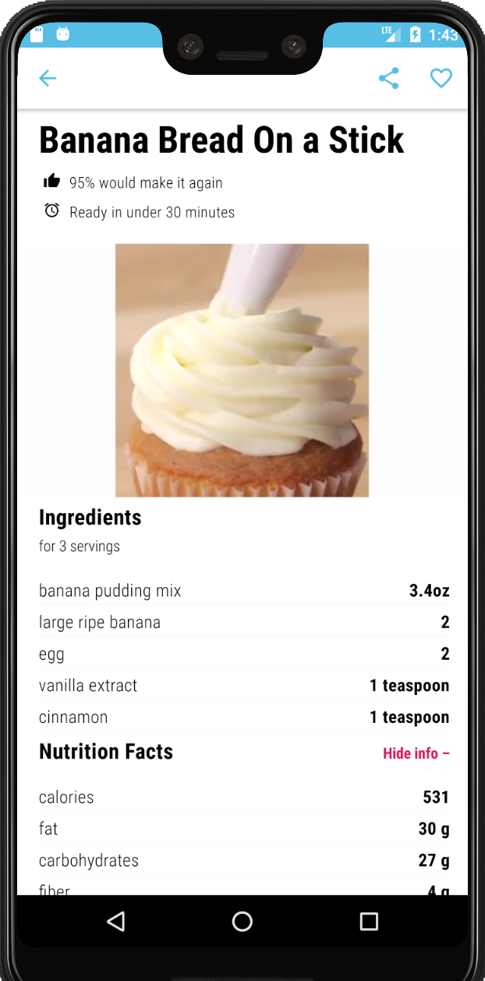
ACCOMPLISHMENTS
Minimum Functionality
Home Page
Login/Sign In
Sign Up
Profile Page
Search Recipe
View Recipe Video, Ingredients And Nutrition Facts

Slide 15
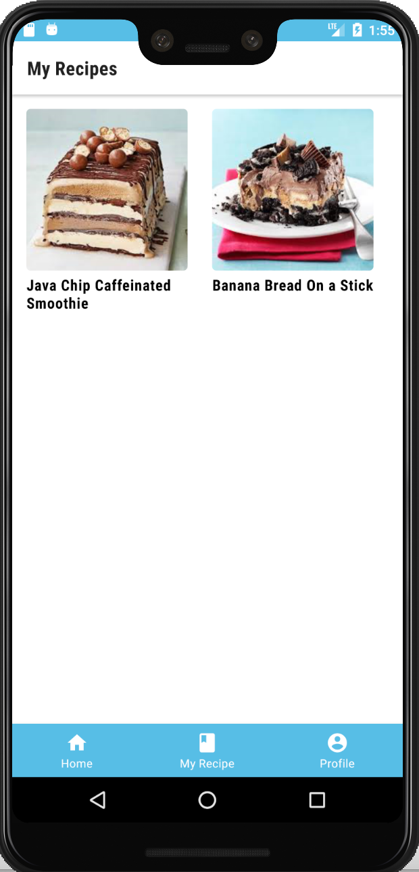
ACCOMPLISHMENTS
Minimum Functionality
Home Page
Login/Sign In
Sign Up
Profile Page
Search Recipe
View Recipe Video, Ingredients And Nutrition Facts
Favourite Recipes Page

Slide 16
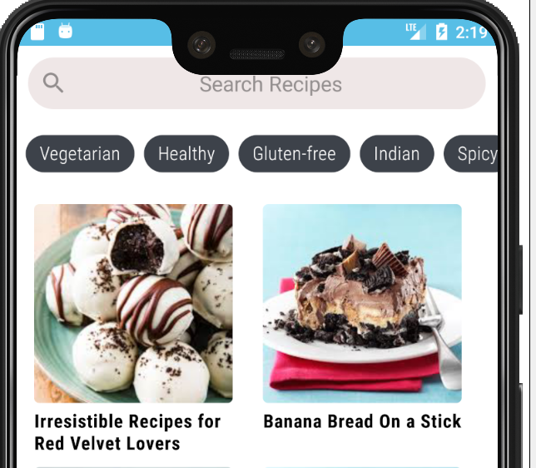
ACCOMPLISHMENTS
Minimum Functionality
Home Page
Login/Sign In
Sign Up
Profile Page
Search Recipe
View Recipe Video, Ingredients And Nutrition Facts
Favourite Recipes Page
Expected Functionality
View Recipes By Category

Slide 17
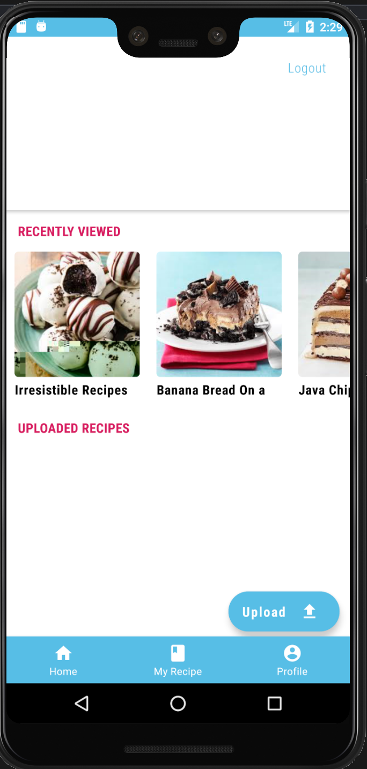
ACCOMPLISHMENTS
Minimum Functionality
Home Page
Login/Sign In
Sign Up
Profile Page
Search Recipe
View Recipe Video, Ingredients And Nutrition Facts
Favourite Recipes Page
Expected Functionality
View Recipes By Category
Upload Recipe

Slide 18
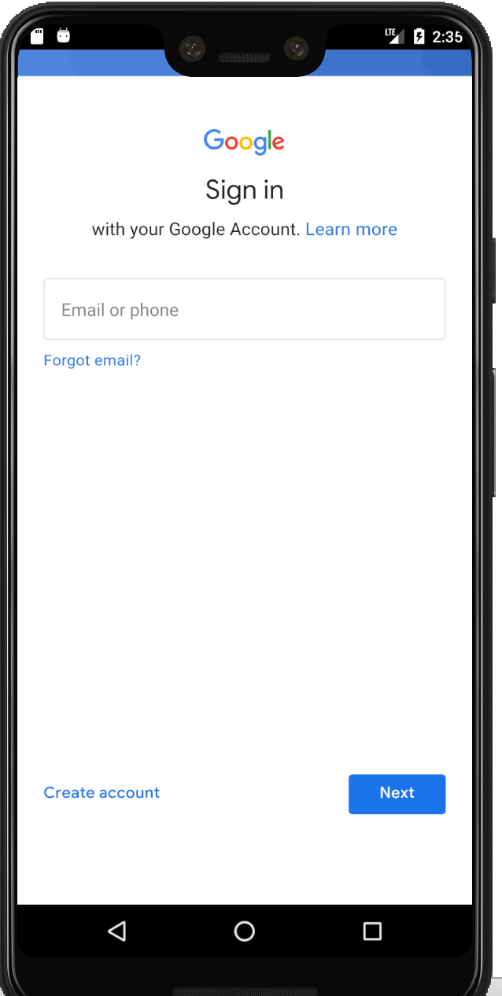
ACCOMPLISHMENTS
Minimum Functionality
Home Page
Login/Sign In
Sign Up
Profile Page
Search Recipe
View Recipe Video, Ingredients And Nutrition Facts
Favourite Recipes Page
Expected Functionality
View Recipes By Category
Upload Recipe
Bonus Functionality
Improved Sign-Up With Google Auth

Slide 19

TESTING
1. Manual Testing
2. Integration Testing
3. Beta Testing

Slide 20

THANK YOU

